Slide 1

{ Topic : Streaming with MongoDB }

Slide 2

Event.Speaker.find({ speaker : { $regex : /amandeep/, $options:'i' } });
{ _id: ObjectId('12345678f44a42adaaaccde') speaker: 'Amandeep Singh Reen', experience : '4+ years in BFSI', gender : 'Male', age : 25 language : [ Java, Python, ........, C++, C], genesis : 'Mumbai', hobby : 'Finding Bugs in My Code',
}

Slide 3
What is Streaming and Why it is essential?

Slide 4
Streaming in General sense.......
Streaming is a method of transmitting or receiving data (especially video and audio material) over a computer network as a steady, continuous flow, allowing playback to start while the rest of the data is still being received.
This is different from downloading, where you need to wait for the entire file to be downloaded before you can start watching or listening.

Slide 5


Slide 6
Streaming in Data Stores.......
Streaming plays a crucial role in data storage and management, especially in the context of handling large volumes of data in real-time
Use Cases
Real-Time Analytics: Monitoring and analyzing data as it is generated.
Log Aggregation: Collecting and processing log data from various sources in real-time.
Data Pipelines: Moving data between systems in real-time for processing and storage.

Slide 7



Slide 8
Why it is Essential?
1. Real-Time Data Processing
Streaming allows for the continuous ingestion and processing of data as it arrives. This is essential for applications that require real-time analytics, such as monitoring systems, financial trading platforms, and IoT devices.
2. Scalability
Streaming systems can handle large volumes of data by distributing the processing load across multiple nodes. This scalability is vital for big data applications where the data flow is constant and voluminous.

Slide 9
Why it is Essential?
3. Efficiency
By processing data in real-time, streaming reduces the need for batch processing, which can be resource-intensive and introduce latency. This efficiency is particularly beneficial for applications that need immediate insights and actions.
4. Event-Driven Architectures
Streaming supports event-driven architectures, where systems react to events as they occur. This is useful for applications like fraud detection, where immediate response to specific events is critical.

Slide 10
Why it is Essential?
5. Data Integration
Streaming facilitates the integration of data from various sources in real-time. This is important for creating unified views of data across different systems, enhancing decision-making and operational efficiency.
6. Cost-Effectiveness
By processing data as it arrives, streaming can reduce storage costs. Instead of storing raw data and processing it later, streaming allows for immediate transformation and storage of only the necessary data.

Slide 11
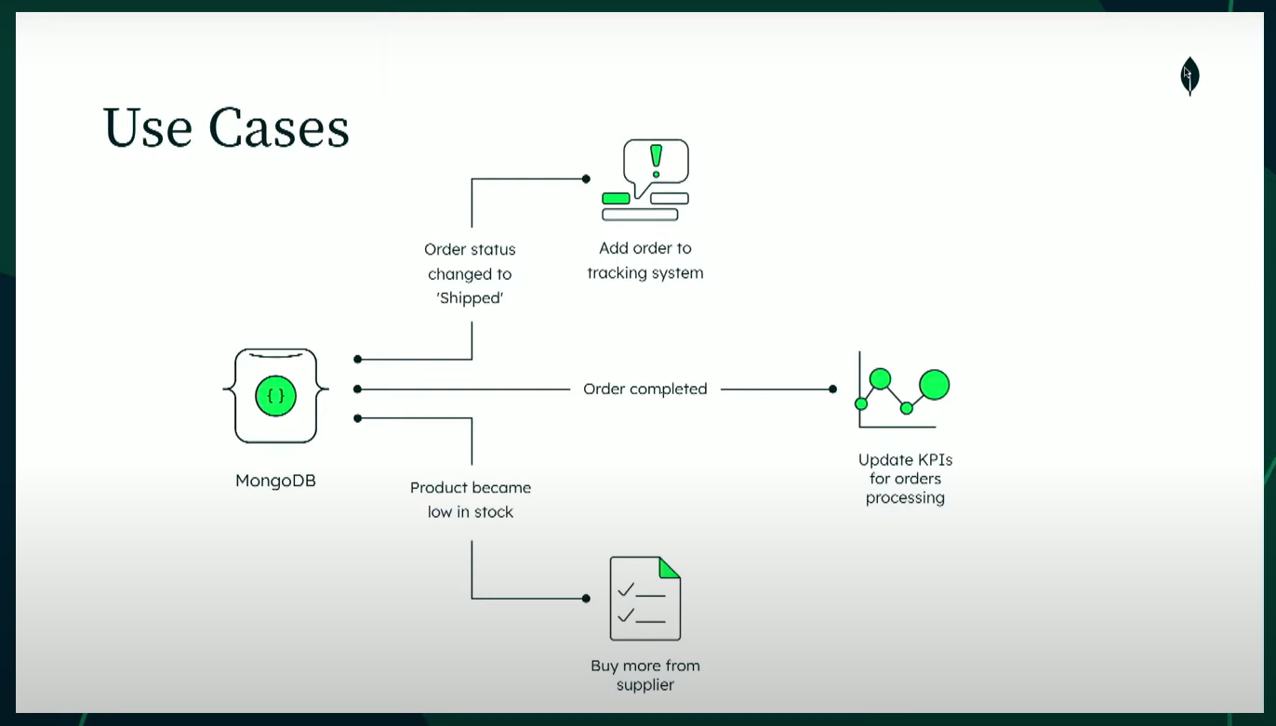
The power of communication

Slide 12
Replica Sets in MongoDB

Slide 13
Replica?
Replication is the method or process of synchronizing data across multiple servers. Replication provides redundancy and high availability. A replica set in MongoDB server is a group of mongod processes in multiple DB server that maintain the same data set, Multiple copies of data on different database servers.
In a replica, one node is the primary node that receives all write operations All other nodes such as secondaries which is an instance in replica apply the same operations from the primary so that they have the same data set. Replica set can have only one primary node which will do write operation. Read operation can be enabled from secondary server but Write operation can only be done from primary node.
Replica set is a group of two or more nodes ( mongo replication needs min of 3 nodes) and one node is primary node and remaining nodes are secondary all data from primary replicates to secondary.

Slide 14
For more insights you can visit the below blog that explain how to create replications.
5 Steps to Configure MongoDB Replication: A Complete Guide

Slide 15
Change Streams in MongoDB

Slide 16
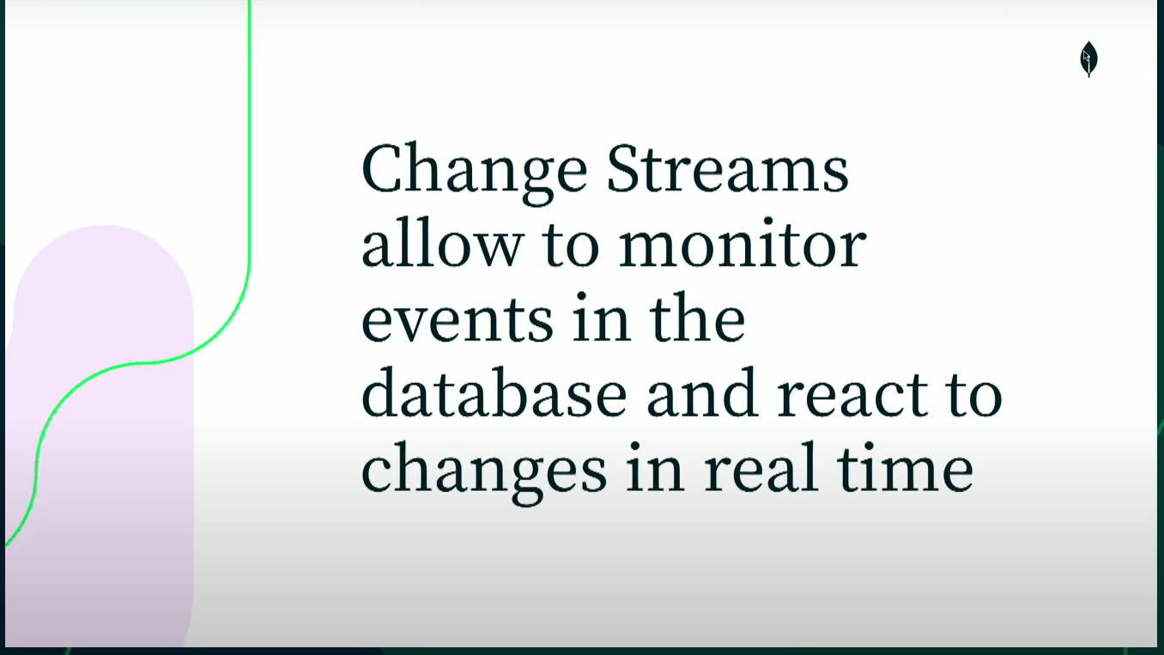
Change Streams in MongoDB

Slide 17
Reference for MongoDb Change Streams
Change Streams - MongoDB Manual v8.0

Slide 18

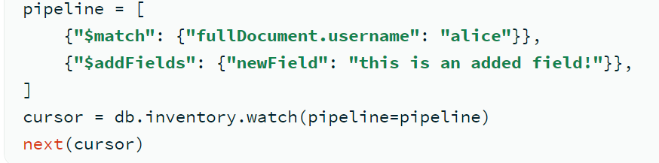
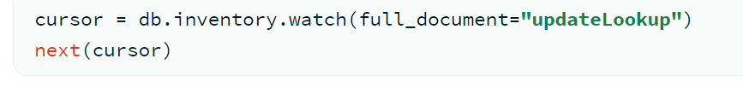

Slide 19
Integrations in MongoDB

Slide 20
Integrations in MongoDB?
MongoDB integrations refer to the various tools and platforms that connect with MongoDB to expand its functionality and improve its usability. These integrations allow MongoDB to work with other applications, making it easier to manage and analyze data.
Common integrations include data visualization tools, BI platforms, and data migration services. They enable users to perform advanced analytics, automate workflows, and synchronize data across multiple systems.
By integrating MongoDB with other technologies, businesses can build more robust applications, enhance data processing capabilities, and gain valuable insights from their data. These integrations are essential for optimizing database performance and achieving greater efficiency in data management tasks.

Slide 21

Apache Spark
Integration with MongoDB

Slide 22
What is Spark?
Apache Spark is an open-source, distributed computing system designed for big data processing and analytics. It provides an interface for programming entire clusters with implicit data parallelism and fault tolerance. Spark is known for its speed and ease of use, supporting various programming languages like Scala, Java, Python, and R.
The integration of Apache Spark with MongoDB is facilitated by the MongoDB Connector for Apache Spark. This connector allows Spark to read from and write to MongoDB, enabling powerful data processing and analytics capabilities.
Apache Spark follows a master-slave architecture designed for distributed data processing

Slide 23


Slide 24
Components of Spark
Driver Program
Role: Acts as the master node.
Function: Manages the execution of the Spark application. It creates the SparkContext, which coordinates the tasks and distributes them across the cluster.
Cluster Manager
Role: Manages resources across the cluster.
Types: Spark can work with various cluster managers like Standalone, Apache Mesos, Hadoop YARN, and Kubernetes1.

Slide 25
Components of Spark
Worker Nodes
- Role: Execute the tasks assigned by the driver.
- Components: Each worker node runs one or more executors.
- Function: Executors are responsible for running the actual computations and storing the data for the Spark application
Executors
Role: Run on worker nodes.
Function: Execute the tasks and return the results to the driver. They also provide in-memory storage for RDDs (Resilient Distributed Datasets) that are cached by user programs through SparkContext

Slide 26
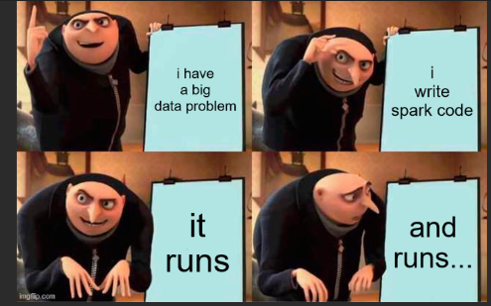

Slide 27



Demo
Integrating Mongo DB with spark code with python script

Slide 28

Thank you
Amandeep Singh Reen

